Slide 1
ASHRAE Standards 15 and 34
Preparing for A2L Refrigerants
Presented by: Sharon Haeg
DISCLAIMER: This presentation is intended only for educational purposes and does not replace independent professional judgment and/or legal advice.
This presentation is copyrighted and cannot be used without the express permission of Daikin Applied Americas Inc.

Slide 2
Disclaimer
The content in these materials is copyrighted by Daikin Applied Americas Inc. (Daikin Applied) and cannot be used without the express written permission of Daikin Applied. This training, along with the related materials, is for educational purposes and is only for the persons attending the training. It is not intended to provide legal or technical advice and does not replace independent professional judgment. While all information in the training materials is provided in good faith, Daikin Applied makes no representation or warranty of any kind, express or implied, regarding the accuracy, adequacy, validity, reliability, availability, or completeness of any information in the training materials. Under no circumstance shall Daikin Applied have any liability to you or any other party for any loss or damage of any kind incurred as a result of the use of the training materials or reliance on any information provided in the training materials. Your use of the training materials and your reliance on any information in the training materials is solely at your own risk. The ultimate responsibility is on the engineer of record to ensure the design complies with all applicable codes and regulations.
Always consult your state & local codes, which may take precedence over standards like ASHRAE Standards 15, 34, or other standards which vary in adoption, complete or partial, by state. Also note that a state may adopt a different year of the standard than the latest version.
The local Authority Having Jurisdiction (AHJ) has the final authority in interpreting code requirements. When in doubt, contact the AHJ.

Slide 3
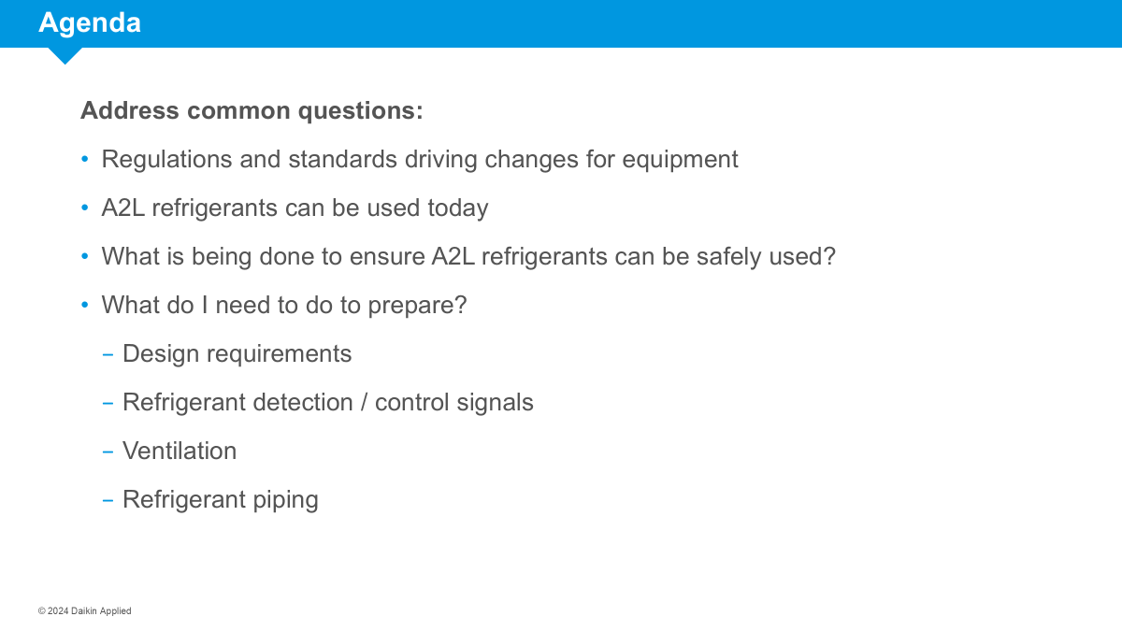
Agenda
Address common questions:
Can I use A2L refrigerants in my jurisdiction?
What is being done to ensure A2L refrigerants can be safely used?
What do I need to do to prepare?
    Design requirements
    Refrigerant detection / control signals
    Ventilation
    Refrigerant piping

Slide 4


AIM Act: Law Passed Dec. 2020 | EPA Rulemaking Status
PHASEDOWN
via CO2eq Allocations of Bulk HFCs
(Supply Side constraints)
TECHNOLOGY TRANSITIONS
Sector based controls
SNAP restrictions
REFRIGERANT MANAGEMENT
Minimizing leaks
Maximizing recovery & reclamation
The AIM Act gives authority to the EPA to phase down HFC refrigerants in the US
Old news: EPA must write rules to phase down production and consumption of bulk HFCs to 15% of baseline, maximize reclamation, minimize releases from equipment and facilitate transition through sector-based restrictions

Slide 5
AIM Act: EPA Phasedown and Allocations
Phasedown Schedule
Production & Import of Bulk HFCs
All sectors
CO2eq = GWP x mass
CO2eq Phasedown
Baseline over 300 million metric tonnes CO2 equivalency
Phases down creating supply shortage of HFCs
Not refrigerant specific – not a phaseout
All bulk virgin HFCs in all sectors
Produced in USA and imported
Existing equipment may be serviced
Installed base can be serviced
Will need to transition to lower GWP refrigerants
2024
2029
2034
2036

Slide 6

AIM Act: EPA Technology Transition
Products - Factory-Charged Equipment
Chillers, RTUs, WSHP, PTAC
3-year sell-through period
*Installation deadline means charging the refrigeration circuit to full charge
Air conditioning equipment, including AC & HP, Chillers (comfort cooling), and ice rinks
Data Centers
1/1/2030
MFG and Import Deadline
Sell-through Deadline
MFG and Import Deadline
Sell-through Deadline
1/1/2028
1/1/2027
1/1/2026
Select states require chillers with GWP limit of 750
Systems - Field-charged equipment:
Split systems, knock-down units
Installation deadline instead of sell-through
Residential / Light Commercial Split system HPs and AC
VRF
MFG and Import Deadline
*Installation Deadline
MFG and Import Deadline
*Installation Deadline (proposed)
1/1/2025
1/1/2024

Slide 7
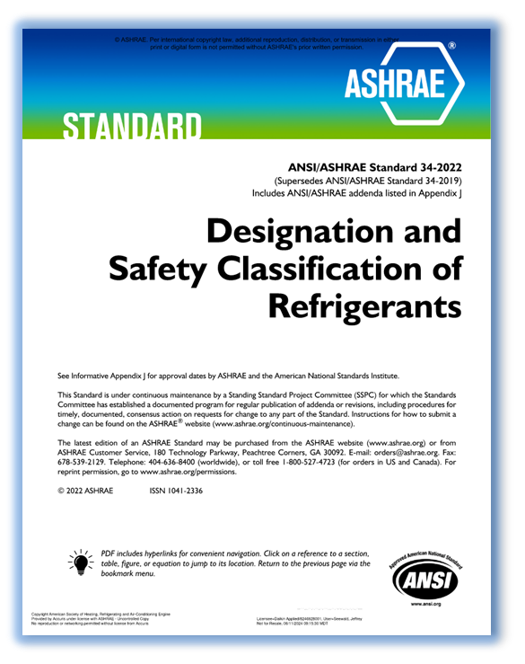
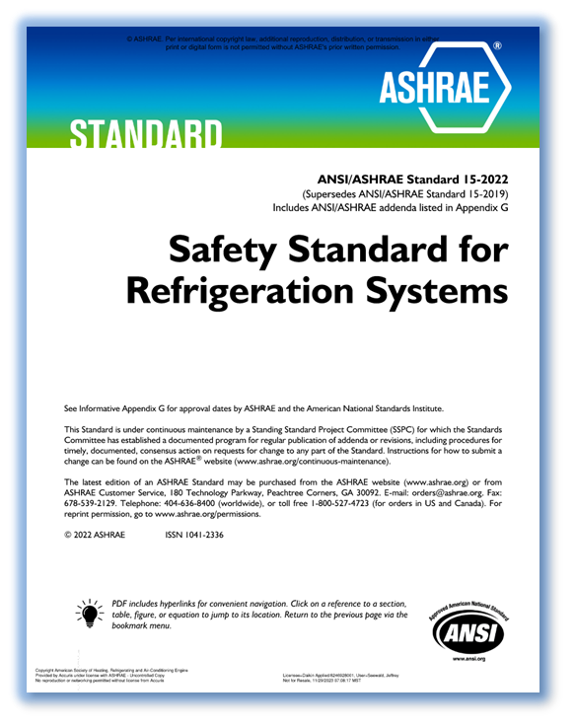
Applicable ASHRAE Standards – 15 and 34
Define Refrigerant Classes and Safety Requirements
The standards are referenced by, or adopted in part/whole, or copied into various building codes
    National model building codes are then adopted by individual jurisdictions
    International Mechanical Code (IMC)
    International Fire Code (IFC)
    Uniform Mechanical Code (UMC)
  State/Local Building Codes
  Published every 3 years
  Note: Canada uses CSA B52 instead of ASHRAE 15

Slide 8
Agenda
Address common questions:
Regulations and standards driving changes for equipment
A2Ls can be used today
What is being done to ensure A2L refrigerants can be safely used?
What do I need to do to prepare?
    Design requirements
    Refrigerant detection / control signals
    Ventilation
    Refrigerant piping

Slide 9
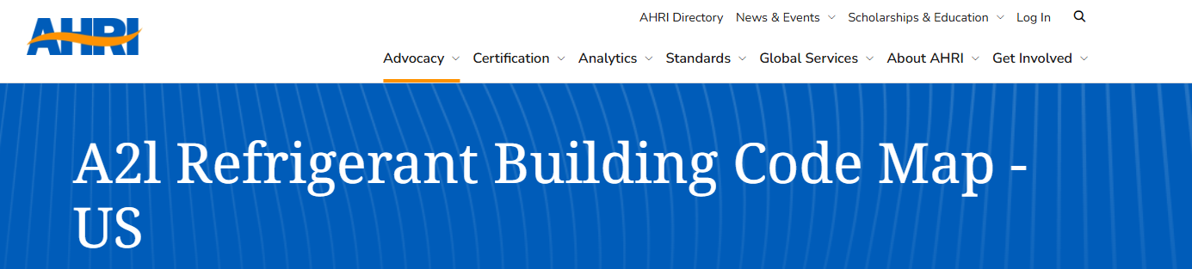
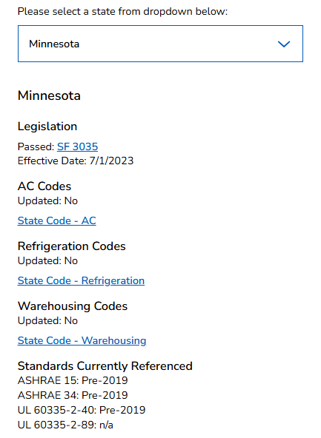
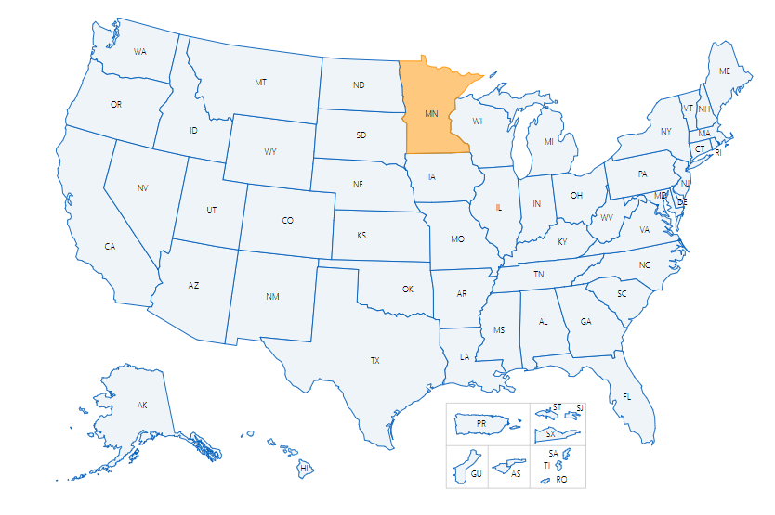
Group A2L Refrigerants Can Be Used Today
AHRI A2L Adoption Map
See how your state has adopted A2Ls
Find applicable codes & legislative language
Requirements differ by edition and local code. When in doubt, contact the Authority Having Jurisdiction (AHJ)
Chillers located in machinery rooms and outdoors are not in occupied spaces, and A2L refrigerants have been permitted in jurisdictions where 2018 or later model code editions are used.
Source: https://www.ahrinet.org/a2l-refrigerant-building-code-map-us?state=MN#map
Notes:
Can I use A2Ls in my states, by and large the answer is yes most state are ready to go would encourage you to look at the resource provided by AHRI
State by state building code map that will guide you to what is the status of your state or perhaps you work across state lines so you can see what are the regulations and requirements in the states you do business with
Would encourage you to utilize this resource that AHRI has provided and familiarize yourself with the codes and standards that apply to your state
Only state as of recording that is a little bit of a hold out is Nevada, they still have a little bit of clean up work to do, most other states are ready and able to use A2Ls today as of January 2025

Slide 10
Agenda
Address common questions:
Regulations and standards driving changes for equipment
A2Ls can be used today
What is being done to ensure A2L refrigerants can be safely used?
What do I need to do to prepare?
    Design requirements
    Refrigerant detection / control signals
    Ventilation
    Refrigerant piping

Slide 11
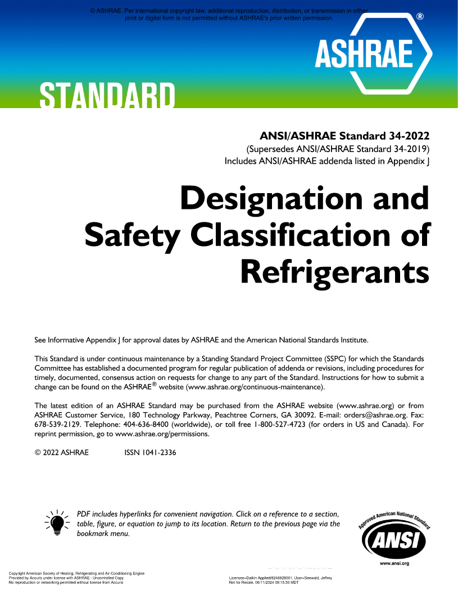
ASHRAE Standard 34-2022
Designation and Safety Classification of Refrigerants
ASHRAE Standard 34 describes a shorthand way of naming refrigerants, and it assigns safety classifications and refrigerant concentration limits based on toxicity and flammability data.
Numbering and designation of refrigerants
Safety group classifications
Refrigerant concentration limits & other data

Slide 12
ASHRAE Standard 34
Terminology
Term | Definition
Burning velocity | The maximum velocity (in/s [cm/s]) at which a laminar flame propagates in a normal direction relative to the unburned gas ahead of it.
HOC | The heat released when a substance is combusted, determined as the difference in the enthalpy between the reactants (refrigerants and air) and their products after combustion as defined in Section 6.1.3.6. The heat or enthalpy of combustion is often expressed as energy per mass (e.g., Btu/lb [kJ/kg]).
LFL | The minimum concentration of a substance, e.g. a refrigerant, that is capable of propagating a flame through a homogeneous mixture of the substance and air under specified test conditions.
FCL | Flammable Concentration Limit, the refrigerant concentration limit, in air, intended to reduce the risk of fire or explosion in normally occupied, enclosed spaces, FCL = 25% × LFL
MIE | Minimum Ignition Energy (MIE) is the lowest energy required to ignite the flammable material in air or oxygen. The lowest value of the Minimum Ignition Energy is found at a certain optimum mixture of fuel and air.
OEL | The time-weighted average (TWA) concentration for a normal eight-hour workday and a 40-hour workweek to which nearly all workers can be repeatedly exposed without adverse effect, based on the OSHA PEL, ACGIH TLV-TWA, TERA OARS-WEEL, or consistent value.
RCL | The refrigerant concentration limit, in air, determined in accordance with this standard and intended to reduce the risks of acute toxicity, asphyxiation, and flammability hazards in normally occupied, enclosed spaces.
ATEL | Acute Toxicity Exposure Limit, a concentration limit intended to reduce the risks of acute toxicity hazards in normally occupied, enclosed spaces
ODL | Oxygen Deprivation Limit, the concentration of a refrigerant or other gas that results in insufficient oxygen for normal breathing

Slide 13
ASHRAE Standard 34
Flammability
Toxicity
Safety
Group
Flammability
Class 3 Higher flammability | A3 | B3
Class 2 Flammable | A2 | B2
Class 2L Lower flammability | A2L | B2L
Class 1 No flame propagation | A1 | B1
 | Lower Toxicity | Higher Toxicity
Toxicity

Slide 14
ASHRAE Standard 34 Basics: RCL
Refrigerant Concentration Limit
RCL
Flammability
Toxicity
Asphyxiation
Establishes maximum allowable concentration of refrigerant based on worst case (lowest value) of:
Flammability risk: FCL
    With factor of safety, FCL = 25% of LFL
Acute toxicity risk: ATEL, worst case of:
    Mortality
    Cardiac sensitization
    Anesthetic or central nervous system effects
    Other escape impairing effects and permanent injury
Asphyxiation risk: ODL
    Oxygen deprivation limit

Slide 15
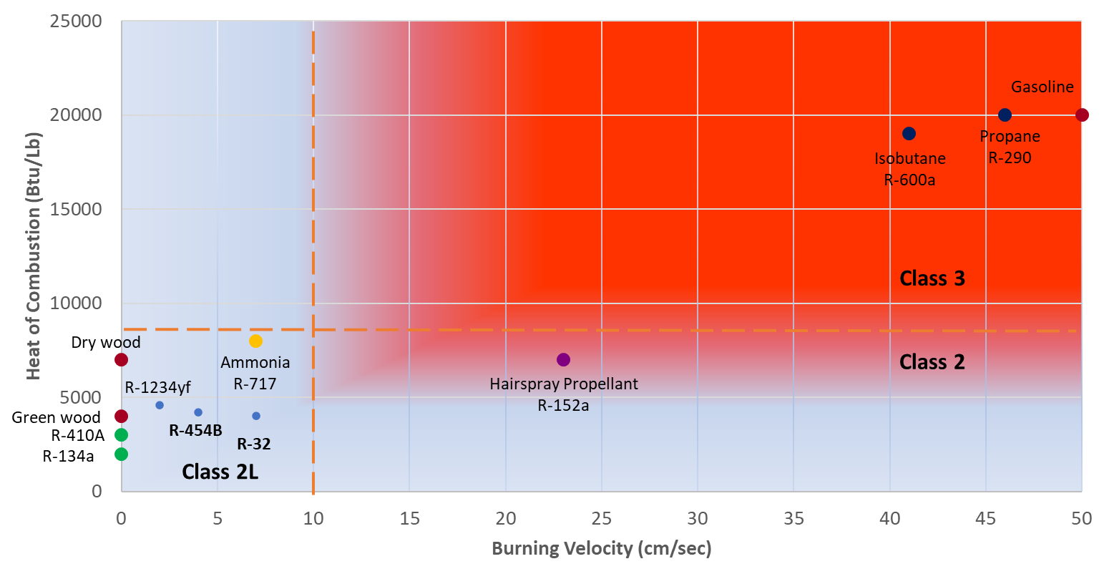
A2L Refrigerants – How Flammable Are They?
A2Ls have ‘lower flammability’
Relatively lower burning velocity & heat generation
Burning Velocity (S_{u})
    How fast does a flame propagate (<0.1 m/s)
Heat of combustion (HOC)
    How much energy is released by burning (< 1900 kJ/kg)
Lower Flammability Limit (LFL)
    What is the concentration required to burn (> 0.1 kg/m³)

Slide 16
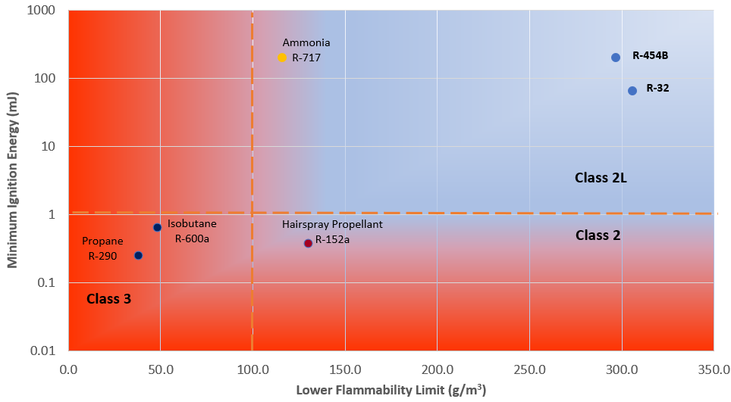
A2L Refrigerants – How Flammable Are They?
A2Ls have ‘lower flammability’
More difficult to ignite / higher concentration required
Burning Velocity (S_{u})
    How fast does a flame propagate (<0.1 m/s)
Heat of combustion (HOC)
    How much energy is released by burning (< 1900 kJ/kg)
Lower Flammability Limit (LFL)
    What is the concentration required to burn (> 0.1 kg/m³)

Slide 17
‘New’ and Legacy Refrigerant Properties
Refrigerant | ASHRAE 34 Classification | GWP100 (AR4) | RCL (g/m³) | Composition | Efficiency | Capacity
R-410A Substitutes
R-410A | A1 | 2088 | 420 | 50% R32 / 50% R125
R-32 | A2L | 675 | 77
R-454B | A2L | 466 | * 74 | 68.9% R32 / 31.1% R1234yf
R-134a Substitutes
R-134a | A1 | 1430 | 210
R-513A | A1 | 631 | 320 | 44% R134a / 56% R1234yf
R-515B | A1 | 293 | 290 | 91.1% R1234ze(E) / 8.9% R227ea
R-1234ze(E) | A2L | 1 | 76
R-123 Substitutes
R-123 | B1 | 77 | 57
R-1233zd(E) | A1 | ~1 | 85
R-514A | B1 | ~2 | 14 | 74.7% R1336mzz(Z) / 25.3% R1130(E)
*Note: ASHRAE 34 previously listed an RCL of 49 but that value was later updated in Addendum “a” of Standard 34-2022.

Slide 18
Agenda
Address common questions:
Regulations and standards driving changes for equipment
A2Ls can be used today
What is being done to ensure A2L refrigerants can be safely used?
What do I need to do to prepare?
    Design requirements
    Refrigerant detection / control signals
    Ventilation
    Refrigerant piping

Slide 19
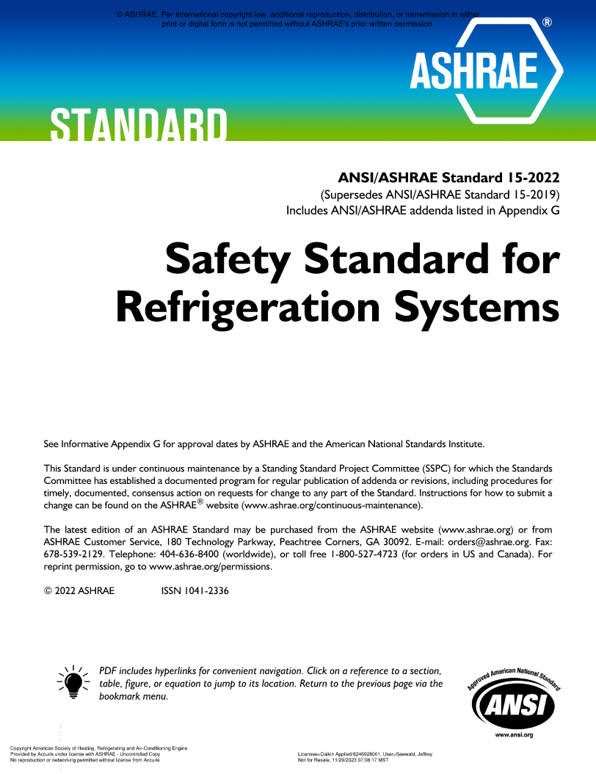
ASHRAE Standard 15-2022
Safety Standard for Refrigeration Systems
ASHRAE Standard 15 specifies requirements for the safe design, construction, installation, and operation of refrigeration systems.
Changes to refrigerant use restrictions, especially for A2Ls
Refrigerant overpressure protection and piping
Volume and refrigerant charge limit calculations
Refrigerant detector/detection and mitigation actions
Machinery room requirements
ASHRAE web site has errata sheet corrections and interpretations. Download them.

Slide 20
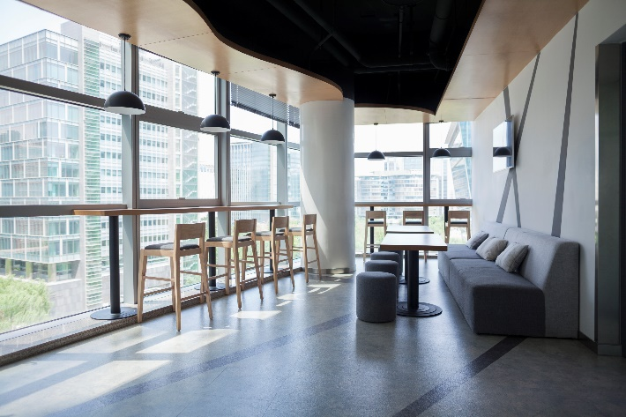

How Will ASHRAE 15-2022 Requirements Impact You?
Lobbies
  System Design
  Unit refrigerant charge must be checked against the volume of the spaces it serves
    Differs by occupancy type and refrigerant safety group
    Both occupied and non-occupied spaces for A2Ls
    Spaces with refrigerant piping must be included (some exceptions apply)
  Restrictions on type of system or refrigerant used in certain areas
    E.g. lobbies, public corridors
  Refrigerant piping that passes through spaces may require special testing and/or construction
Institutional Occupancies

Slide 21
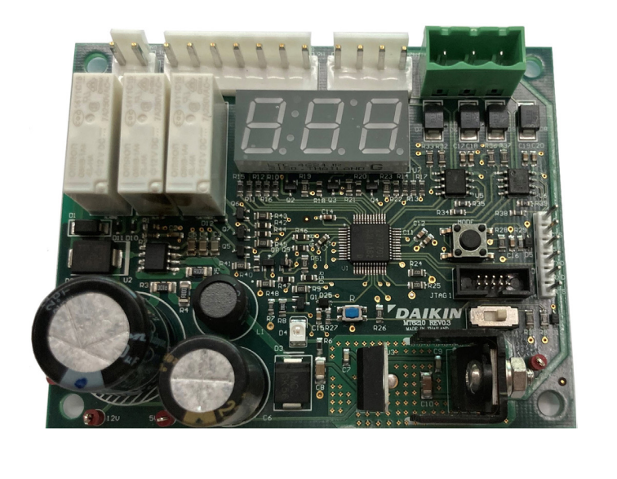
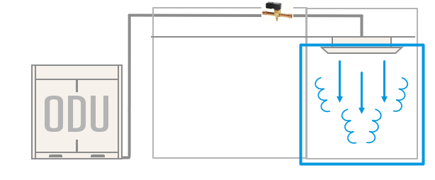
How Will ASHRAE 15-2022 Requirements Impact You?
Refrigerant Detection System
Installation / Controls Integration:
Units may require a ‘Refrigerant Detection System’ (RDS) or ‘Release Mitigation Controls’
  Hardware is required to complete certain functions and output specific signals
  Installers may need to connect these signals to other parts of the HVAC system
    e.g. dampers, ventilation fans, electrical interlocks, release mitigation controls, etc
  Release Mitigation Controls:
    Connected to RDS
    Limits amount of refrigerant that can leak
    Mostly used on smaller split systems, limited to indoor units of 5 Tons or smaller
Release Mitigation Controls

Slide 22
ASHRAE Standard 15
Refrigerant limit
Integral refrigerant detection system
Mitigation
Ventilation
Circulate air
Open zone dampers
Deenergize heat and ignition sources
Activate shutoff valves
Ventilate
Exhaust leaked refrigerant
Volume
EDVC
Refrigerant detection
“Listed” equipment
UL 60335-2-40 / CSA C22.2 No. 60335‑2‑40
UL 484
Ignition
No ignition sources in ductwork
Occupancy
Requirements
Refrigeration System
Safety Group
A
1
When a leak is detected
2
B
3
4
5
C
6

Slide 23
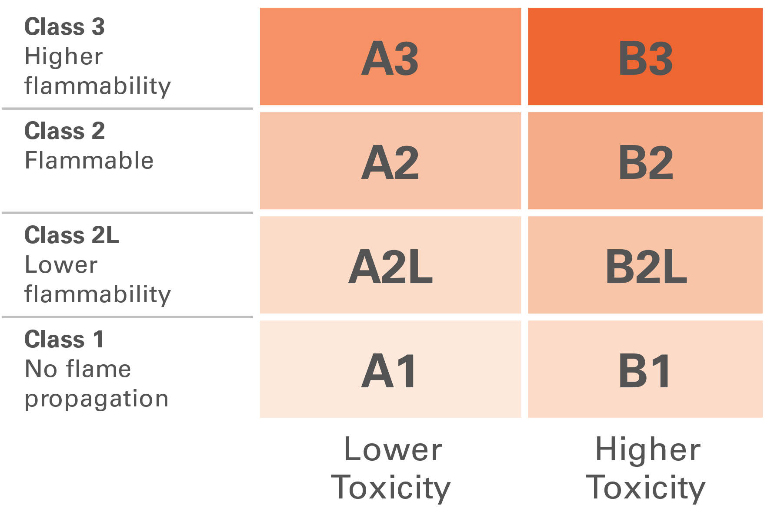
ASHRAE Standard 15
A
B
C
Occupancy Classification
Refrigeration System Classification
Safety Group
ASHRAE Standard 15, Section 4
Different occupancy types may require different actions
ASHRAE Standard 15, Section 5
ASHRAE Standard 15, Section 6
Per ASHRAE Standard 34
Classification
Institutional
Public assembly
Residential
Commercial
Large mercantile
Industrial
Mixed
Classification
High Probability
Low Probability

Slide 24
ASHRAE Standard 15
Occupancy Classification
Classification | Definition A premise or that portion of a premise… | Examples
Institutional | from which, because they are disabled, debilitated, or confined, occupants cannot readily leave without the assistance of others | Hospitals, nursing homes, prisons
Public assembly | here large numbers of people congregate and from which occupants cannot quickly vacate the space | Auditoriums, ballrooms, classrooms, restaurants, theaters, depots
Residential | that provides the occupants with complete independent living facilities, including permanent provisions for living, sleeping, eating, cooking, and sanitation | Hotels, dormitories, apartments
Commercial | where people transact business, receive personal service, or purchase food and other goods | Office and professional buildings, markets (excluding large mercantile)
Large mercantile | where more than 100 persons congregate on levels above or below street level to purchase personal merchandise | Shopping malls
Industrial | is a premise or that portion of a premise that is not open to the public, where access by authorized persons is controlled, and that is used to manufacture, process, or store goods | Manufacturing plants, processing plants, storage facilities
Mixed | two or more occupancies are located within the same building | Combination of one or more of the above space types

Slide 25
ASHRAE Standard 15
B
Refrigeration System Classification
Classification | Definition | Examples
High Probability | Any system where leakage of refrigerant has high probability to enter the occupied space. | Direct Systems Direct expansion (DX) split system Packaged RTU Water source heat pump VRF PTAC
Low Probability | Any system where leakage of refrigerant cannot enter the occupied space. | Indirect closed systems Water-cooled chiller in machinery room Air-cooled chiller outdoors Water-to-water heat pump in machinery room

Slide 26
Requirements
 | ASHRAE Standard 15 Topic | Requirement(s)
 | Refrigerant limit | Volume calculations Connected spaces Natural ventilation openings Charge limits EDVC calculation
 | Refrigerant detection | Integral refrigerant detection system
 | Mitigation | Circulate air Open zone dampers Deenergize heat and ignition sources Activate shutoff valves Ventilate
 | Ventilation | Exhaust leaked refrigerant
 | Ignition | No ignition sources in ductwork
 | Listed equipment | UL 60335-2-40 / CSA C22.2 No. 60335-2-40 UL 484
1
2
3
4
5
6

Slide 27
Refrigerant Limits
1
Natural Ventilation Between Spaces
Circulation
Ventilation
Mitigation Controls
Check the releasable refrigerant charge (M_{rel}) against the Effective Dispersal Volume Charge (EDVC)
    The smallest volume into which refrigerant disperses shall be used when determining EDVC
    For A2Ls, both occupied and non-occupied spaces must be considered (7.2.2.2)
Equations to calculate EDVC vary depending on refrigerant safety group and system characteristics
If you don’t comply initially, you can consider additional mitigation strategies
M_{rel} ≤ EDVC

Slide 28
Volume Calculations
1
Connected spaces can help comply with EDVC requirements
Natural ventilation openings may be used to increase the effective dispersal volume by connecting separate enclosed spaces with openings to allow refrigerant to disperse
Size openings in accordance with sections 7.2.3.2.1 or 7.2.3.2.2
  Any openings above 12in from the floor shall not be considered
Notes:
Note to Facilitator: 

Slide 29
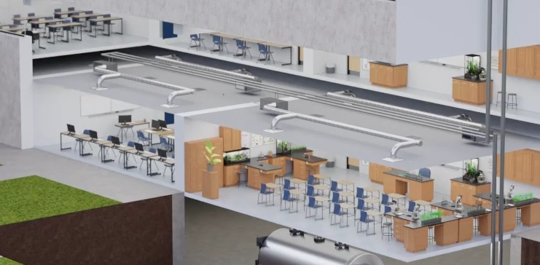
Volume Calculations
1
Connected spaces can help comply with EDVC requirements
Ducted Air Distribution and Mechanical Ventilation Systems may be used to increase the effective dispersal volume by connecting separate enclosed spaces
Follow guidelines for Connected Spaces via Ducted Air Distribution System 7.2.3.3 and/or Connected Spaces via Mechanical Ventilation 7.2.3.4
Notes:
Note to Facilitator: 

Slide 30
Refrigerant Limits: EDVC
General Steps:
Notes:
  Establish Effective Dispersal Volume (7.2.3.1 to 7.2.3.4) of occupied and non occupied spaces (occupied only for A1 refrigerants)
    Identify exempted spaces (7.2.3.1.1)
    Determine if any spaces are ‘connected spaces’ via natural openings or through air circulation
    Consider closures (such as dampers that can close during a refrigerant leak)
  Calculate EDVC per the equation in 7.3.1
    Or, apply 7.6.1.1 for an A2L refrigerant with detection and air circulation
    Or, apply 7.6.1.2 for an A2L refrigerant without detection and air circulation
    Consider natural ventilation openings (there are height restrictions and opening size requirements per 7.2.3.2
    Where a refrigeration system or a part thereof is located within an air distribution duct system or in a space served by an air distribution duct system, the entire air distribution system shall be analyzed to determine the worst-case distribution of leaked refrigerant. (7.2.3.3)
    Where two or more spaces are connected by a mechanical ventilation system complying with the requirements of Section 7.6.4, the volume of all such connected spaces shall be included in the effective dispersal volume used to calculate the EDVC in Section 7.3. (7.2.3.4)

Slide 31
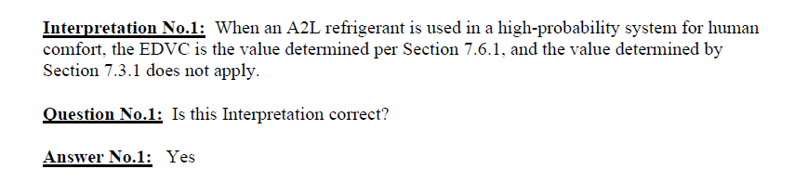
Refrigerant Limits: Simplified Flowchart
Flammability class of 1?
Yes
EDVC determined per 7.3.1 using the occupied space identified by Section 7.2.2.1
1
  Refrigerant System Charge Limit Compliance Path
  Simplified flowchart (Figures 7-1 and 7-2)
  Simplifying assumptions:
    Unit has a refrigerant charge > 22 lb
    The unit is not in a public corridor or lobby
    High probability system for human comfort not in a machinery room or outdoors
    Not in a laboratory
    Not an industrial occupancy or refrigerated room
No
EDVC shall be determined per Section *7.3.1 [7.6.1] using the enclosed space identified by Section 7.2.2.2
Does the system use release mitigation controls complying with 7.3.4.4?
Yes
*Note: Standard 15-2022 Figure 7-2 indicates 7.3.1 but a later interpretation clarified that 7.6.1 applies instead of 7.3.1 for calculating EDVC for A2Ls
No
Releasable charge, m_{rel}, is the system charge, m_{s}, of each independent circuit
Releasable charge, m_{rel}, is determined per Section 7.3.4.3 for each independent circuit
Is the releasable charge, m_{rel}, of each independent circuit ≤ EDVC?
No
Yes
Charge unacceptable for the space
System charge is in compliance

Slide 32
Refrigerant Limits: Notable Exceptions
1
Listed equipment with refrigerant charge ≤ 6.6 lb
    If in a public corridor or lobby, must be a unit system and if not an A1, have EDVC calculated
    If not in a public corridor or lobby, charge complies if installed in accordance with listing and OEM instructions
Systems in industrial occupancy or refrigerated room
    If all conditions of Section 7.3.3 are met, are considered to have system charge in compliance
Listed self-contained equipment in a commercial occupancy, not in a public corridor or lobby, with refrigerant charge ≤ 22 lb
    System charge considered in compliance
    Self-contained system definition: a complete, factory-assembled and factory-tested system that is shipped in one or more sections and has no refrigerant-containing parts that are joined in the field by other than companion valves or block valves

Slide 33

Refrigerant Limits: EDVC Calculation
1

Slide 34

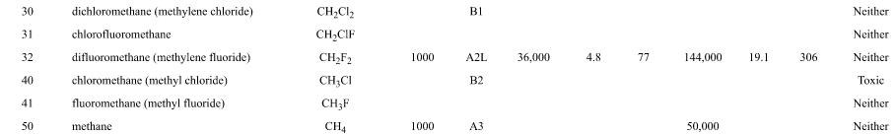


Refrigerant Limits: EDVC Calculation
Identify:
    Occupancy classification: Commercial, F_{occ} = 1.0
    Refrigeration system classification: High probability
Look up:
    refrigerant LFL in ASHRAE Standard 34, Table 4-1 = 0.0191 lb/ft³
Determine the releasable refrigerant charge, m_{rel}
    m_{rel} = 31.2 lb
  Calculate EDVC per ASHRAE Standard 15, Section 7.6.1.1, where unit has air circulation initiated by refrigerant detection
1
$$EDVC=Veff×LFL×CF×Focc$$
$$EDVC=60,000 ft3×0.0191lb/ft3×0.5×1.0$$
$$EDVC=573 lb$$

Slide 35
Refrigerant Detection Systems (7.6.2.3)
2
Refrigerant detectors required when:
  Ducted HVAC systems with a releasable refrigerant charge (m_{rel}) more than 4.0 lb (1.8 kg) and with any duct openings less than 5.9 ft (1.8 m) above the finished floor
  Ducted HVAC systems where spaces connected to the same supply air duct are used as the dispersal floor area to calculate volume per Section 7.2
  Refrigeration systems installed where the occupancy classification is institutional occupancy
Device output signals may need to be connected to other parts of the system (i.e. air dampers, blowers, etc) and must comply with the following:
  Setpoint is not field adjustable
  Field recalibration shall not be permitted.
  Be capable of detecting the presence of the refrigerant used in the system
  Have access for replacement of refrigerant detection system components.
  Have self-diagnostics to determine operational status of the sensing element.
    Energize air circulation fans of the equipment upon failure of a self-diagnostic check.
  Generate an output signal in no more than 30 seconds

Slide 36
Mitigation
3
Mitigation Action Requirements (7.6.2.5)
The following mitigation actions shall be completed in not more than 15 seconds after the initiation of the output signal of Section 7.6.2.4(g), and shall be maintained for at least 5 minutes after the output signal has reset:
Energize the air circulation fan(s) of the equipment
Open zoning dampers
Activate mechanical ventilation
De-energize electric resistance heat installed in the air duct that is connected to the refrigeration system.
* Activate safety shutoff valves utilized to reduce releasable refrigerant charge.
* De-energize potential ignition sources
per the manufacturer’s instructions.
or set zone dampers to full airflow set point, that are installed in the air ducts connected to the refrigeration system.
if required by Section 7.6.4.
including open flames and unclassified electrical sources of ignition with apparent power rating greater than 1 kVA, where the apparent power is the product of the circuit voltage and current rating.

Slide 37
Mitigation
3
    Release Mitigation Controls: Safety Shut Off Valves (7.3.4.4)
Some equipment may include Safety Shut Off Valves (SSOV) to close when a leak is detected and limit the amount of refrigerant that can escape
There are limits to when these devices can be used
    7.3.4.4(b): Release mitigation controls shall only be permitted for reducing the releasable refrigerant charge (m_{rel}) on a refrigeration system where each indoor unit has a cooling capacity of 5 tons (17.5 kW) or less.
These controls are used to provide a smaller ‘releasable refrigerant charge’ to help comply with EDVC

Slide 38

Ventilation (7.6.4)
4
Mechanical Ventilation (when required)
Enable circulation fan
Mechanical ventilation shall be provided that will remove leaked refrigerant from the space where refrigerant leaking from the refrigeration system is expected to accumulate.
Ventilation can be continuous or enabled via refrigerant detection system.
Ventilation does not have to be to the outdoors
There are requirements for make-up air and disabling ignition sources
Requirements for locating openings to facilitate mixing and prevent exhaust recirculation
For units with refrigerant detection, the unit’s circulation fan must be enabled upon detection of a leak
The space shall be provided with an exhaust or transfer fan. Fans used to exhaust air from the space or transfer air to a separate indoor space shall comply with Equation 7-10
Other energy codes may prohibit continuous fan operation
it can be to an alternative space
Equation 7-10:
$$Qmin=\frac{Qreq}{CLFL}$$
Where,
Q_{min} = minimum mechanical ventilation airflow rate, ft³/min (m³/h)
Q_{req} = required ventilation as determined from Table 7-4
C_{LFL} = lower flammability limit conversion factor as determined from Table 7-5

Slide 39

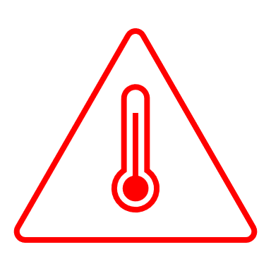
Ignition Sources
5
Ignition Sources in Ductwork (7.6.3)
Open flame producing devices shall not be permanently installed in ductwork
Unclassified electrical devices shall not be located in ductwork
No devices with hot surfaces exceeding 1,290°F
    Unless air flow velocity exceeds 200 ft/min
    And, there is proof of air flow when the device is energized
Generally, the idea is to have heat sources in a listed unit, rather than separately in the ductwork

Slide 40
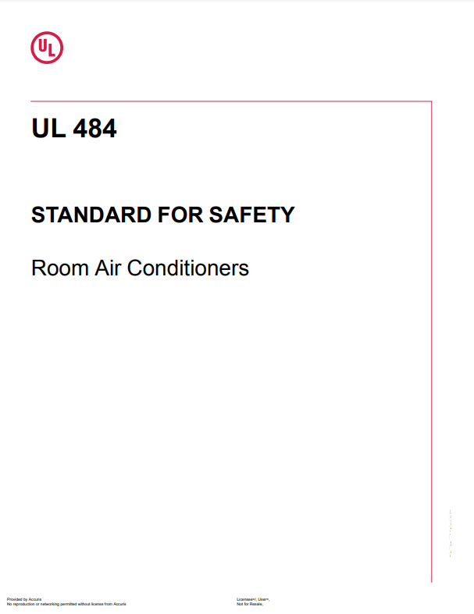
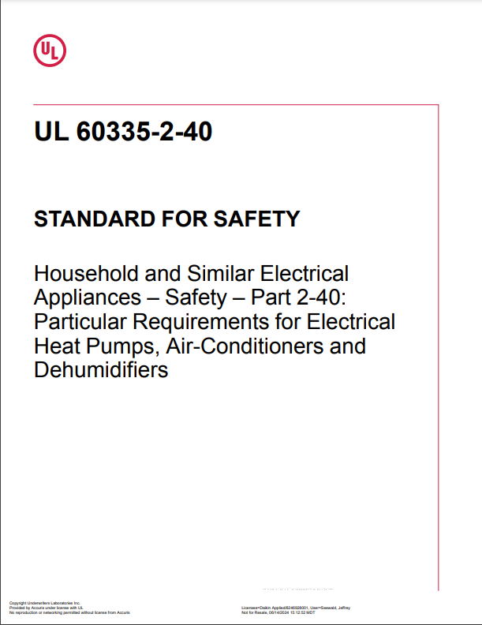
Listed Equipment
6
Product Safety Standard(s)
Refrigeration systems must be listed in accordance with UL 484 or UL 60335-2-40 / CSA C22.2 No. 60335-2-40 for HVAC equipment with A2L refrigerants
Requires certain information that OEMs must include in IOMs. For example:
    Spaces where refrigerant pipes are allowed
    Handling, installation, cleaning, servicing and disposal of refrigerant
  Always refer to the manufacturer’s IOM for specific installation requirements!

Slide 41
Refrigerant Piping
Spaces with refrigerant piping must be included in EDVC calculations except:
    areas that contain only continuous refrigerant piping, or
    contain only joints and connections that have been tested in accordance with Section 9.13
  Refrigerant piping requires special construction per Section 9.12. Some examples (there are more):
    Refrigerant piping that penetrates two or more floor/ceiling assemblies shall be enclosed in a fire-resistance-rated shaft enclosure.
    Refrigerant pipe shafts with systems using only Group A2L or B2L refrigerants shall be naturally or mechanically ventilated.
    Refrigerant pipe shafts with one or more systems using any Group A2, A3, B2, or B3 refrigerant shall be continuously mechanically ventilated and shall include a refrigerant detector.
    Continuous protection via shield plates for concealed piping may be required for non-A1 and non-B1 refrigerants per 9.12.2.1

Slide 42
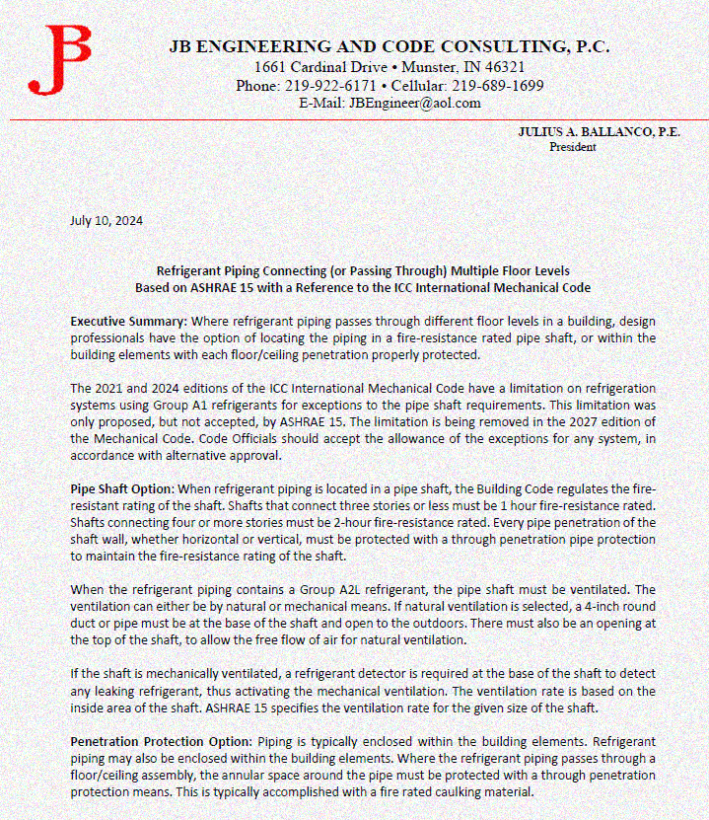
Refrigerant Piping – Alternative method
We can provide a letter from a professional engineer that explains the following in more detail:
Executive Summary:
Where refrigerant piping passes through different floor levels in a building, design professionals have the option of locating the piping in a fire-resistance rated pipe shaft, or within the building elements with each floor/ceiling penetration properly protected.
The 2021 and 2024 editions of the ICC International Mechanical Code have a limitation for exceptions to the pipe shaft requirements to only allow on refrigeration systems using Group A1 refrigerants . This limitation was proposed to, but not accepted by, by ASHRAE 15.
We are hearing that the limitation is likely being removed in the 2027 edition of the IMC.
In the meantime, Code Officials should consider to accept the allowance of the exceptions for any system, not just Group A1 refrigerants, in accordance with alternative approval.

Slide 43
Notable Requirements for Machinery Rooms
  Some notable requirements:
    Tight fitting doors
    Access restriction to authorized personnel
    No airflow to or from an occupied space
    Refrigerant detectors that can actuate an alarm and mechanical ventilation
  8.11.1 to 8.11.7 define special requirements for A2L and B2L refrigerants.
  Elimination or interlocks of ignition sources
  Ventilation for 2 different alarm states
    Trouble (set point ≤ OEL): respond within 300 seconds, automatic reset of alarm and ventilation is permissible
    Emergency (set point ≤ RCL): respond within 15 seconds, manual reset required for alarm and ventilation, higher CFM requirements
Machinery Room Requirements

Slide 44
Notable Requirements for Machinery Rooms
Machinery Room Features
Refrigerant detection
Visible and audible alarms
Vented to outdoors
    Low inlet
    Powered exhaust fan
  Outdoor air intakes
Two ventilation rates (A2L & B2L):
    Level 1: Trouble (> OEL)
    Level 2: Emergency Alarm (> RCL)
Machinery: Refrigerating equipment forming a part of the refrigerating system, including (but not limited to) any or all of the following: compressor, condenser, liquid receiver, evaporator, and connecting piping
Machinery Room: A designated space meeting the requirements of Sections 8.9, 8.10, and 8.11 that contains one or more refrigerating systems or portions thereof, such as compressors and pressure vessels

Slide 45
Machinery Room Ventilation Rates – Everything Except A2L and B2L
General Ventilation Requirements
Status | Ventilation Rate
Operated whenever machinery room is occupied | Continuously, at 0.5 cfm/ft² (0.00254 m³/s per m²) of machinery room floor area, OR 20 cfm (0.00944 m³/s) per person
Operated whenever machinery room is occupied | Intermittently, at the airflow rate required to not exceed the higher of: machinery room temperature 18°F (10°C) above the inlet air temperature, OR machinery room temperature exceeding 122°F (50°C)
Ventilation during leak event (setpoint ≤ OEL) | CFM = 100 × G^{0.5} G = largest circuit ref. charge (lbs)

Slide 46
Machinery Room Ventilation Rates – A2L & B2L
Refrigerant Detector Set Points, Response Times, Alarms, and Ventilation Levels
Limit Value | Response Time (s) | Alarm Type | Alarm Reset Type | Ventilation Level | Ventilation Reset Type
Set point ≤ OEL | ≤ 300 | Trouble | Automatic | Level 1 | Automatic
Set point ≤ RCL | ≤ 15 | Emergency | Manual | Level 2 | Manual
Level 1: Occupied or Trouble
Status | Level 1 Ventilation Rate
Operated whenever machinery room is occupied, AND Operated if refrigerant detector indicates refrigerant concentration exceeds the “trouble alarm” setpoint (must be set ≤ OEL) | Continuously, at the higher of the following airflow rates: 0.5 cfm/ft² (0.00254 m³/s per m²) of machinery room floor area, OR 20 cfm (0.00944 m³/s) per person
Whenever machinery room is occupied | Intermittently, at the airflow rate required to not exceed the higher of: machinery room temperature 18°F (10°C) above the inlet air temperature, OR machinery room temperature exceeding 122°F (50°C)

Slide 47
Machinery Room Ventilation Rates
Level 2: Emergency (For A2Ls)
Refrigerant Charge, G | Level 2 Ventilation Rate, Q
G < 0.1 × G’ | Q >= Q' × 0.102 And Q >= Q₁
0.1 × G' <= G <= G' | Q >= Q' × [1 + 0.39 × ln (G/G’)] And Q >= Q₁
G > G' | Q >= Q’
Based on largest refrigerant charge & unit design pressure
Cannot be less than the Level 1 rate
A2Ls have more lenient mechanical room design requirements than class 2 or 3 refrigerants but may have higher ventilation rates during a Level 2 leak event
Round up Q to 2 significant digits
*Note: See section ASHRAE Standard 15-2022, section 8.11
Sample Calculation
Refrigerant | R-515B (A1) | R-1234ze (A2L)
Charge / Pressure | Largest Circuit Charge = 1000 lb | Largest Circuit Charge = 1000 lb Pressure = 14.7 + 185 psig = 199.7 psia
Method | Section 8.9.8.1: CFM = 100 × G^{0.5} | Section 8.11.11: Table 8-3 or Figure 8-1
Example | Q = 100 × G^{0.5 = 100} = 100 × 1000^{0.5}= 3,162 cfm Q = 3,200 cfm | G’ = 21200 × p^{-0.72} = 21200 × 199.7^{-0.72} = 467.8 lb Q’ = 646 × p^{0.62} = 646 × 199.7^{0.62} = 17,240 cfm G > G’, therefore Q >= Q’ Q = 18,000 cfm

Slide 48
Machinery Room Ventilation Rates
Level 2: Emergency (For A2Ls)
Refrigerant Charge, G | Level 2 Ventilation Rate, Q
G < 0.1 × G’ | Q >= Q' × 0.102 And Q >= Q₁
0.1 × G' <= G <= G' | Q >= Q' × [1 + 0.39 × ln (G/G’)] And Q >= Q₁
G > G' | Q >= Q’
Based on largest refrigerant charge & unit design pressure
Cannot be less than the Level 1 rate
A2Ls have more lenient mechanical room design requirements than class 2 or 3 refrigerants but may have higher ventilation rates during a Level 2 leak event
Round up Q to 2 significant digits
*Note: See section ASHRAE Standard 15-2022, section 8.11
Sample Calculation
Refrigerant | R-515B (A1) | R-1234ze (A2L)
Charge / Pressure | Largest Circuit Charge = 1000 lb | Largest Circuit Charge = 1000 lb Pressure = 14.7 + 185 psig = 199.7 psia
Method | Section 8.9.8.1: CFM = 100 × G^{0.5} | Section 8.11.11: Table 8-3 or Figure 8-1
Example | Q = 100 × G^{0.5 = 100} = 100 × 1000^{0.5}= 3,162 cfm Q = 3,200 cfm | G’ = 21200 × p^{-0.72} = 21200 × 199.7^{-0.72} = 467.8 lb Q’ = 646 × p^{0.62} = 646 × 199.7^{0.62} = 17,240 cfm G > G’, therefore Q >= Q’ Q = 18,000 cfm
Note: Using Figure 8-1 may result in a higher ventilation rate than Table 8-3 when design pressure is on the lower end of each bucket

Slide 49


Where Can I Go for Information?
General Guidance:
https://www.daikinapplied.com/training
https://www.ahrinet.org/saferefrigerant
https://www.escogroup.org/training/lowgwprefrigerant.html
https://www.acca.org/education/a2l-refrigerants
https://www.rses.org/training/lowgwpa2l.aspx
https://www.r32reasons.com/
https://www.ashrae.org/technical-resources/bookstore/ashrae-refrigeration-resources
https://www.achrnews.com/articles/153195-understanding-a2l-refrigerants
https://www.esmagazine.com/articles/99996-a2l-refrigerants-safely-addressing-refrigerant-flammability-concerns

Slide 50
Where Can I Go for Information?
Building Codes:
https://www.iccsafe.org/products-and-services/i-codes/a2l-refrigerants-transition/
https://www.ahrinet.org/a2l-refrigerant-building-code-map?state=OH#map
https://www.ashrae.org/technical-resources/standards-and-guidelines/read-only-versions-of-ashrae-standards
https://www.iapmo.org/media/31999/2024-umc-code-changes-randy-young.pdf
https://www.iccsafe.org/products-and-services/i-codes/a2l-refrigerants-transition/
Presentations and Podcasts
https://www.ashrae.org/news/ashraejournal/ashrae-journal-podcast-episode-37
AHRI Webcast Series
    An Introduction to A2L Refrigerants
    A2L Refrigerants Webinar Series Part 2 - Updates to Standards and Model Codes
    A2L Refrigerants Webinar Series Part 3: State and Local Codes and Available Resources

Slide 51
Thank you for your time and attention
For more information, contact:
Sharon Haeg
Sharon.Haeg@daikinapplied.com

